Slide 1

Senior Design Project
Rozerin Yıldız
Muğla Sıtkı Koçman University
Department of Computer Engineering
Advisor
Dr. Tuğba ÖNAL SÜZEK
Muğla Sıtkı Koçman University
Department of Computer Engineering

Slide 2
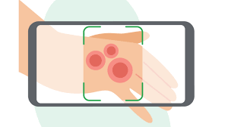
Project: Skin Disease Detection Application

Slide 3
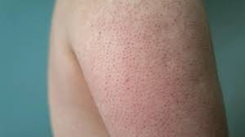
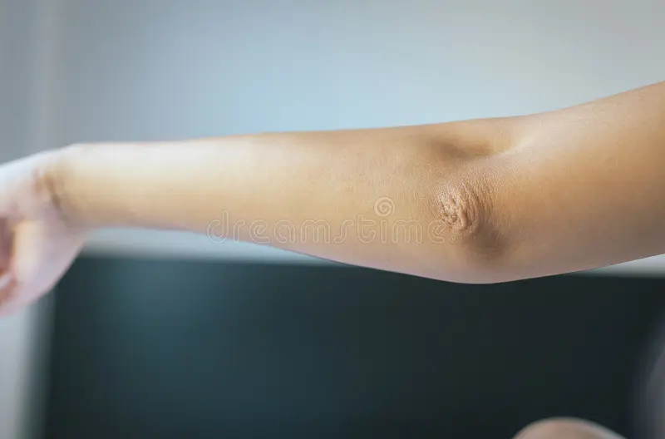
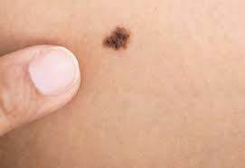
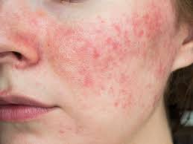
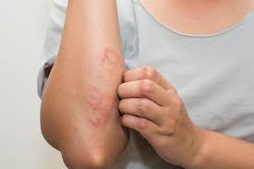
Classes
Eczema
Healthy
Keratosis pilaris
Rosacea
Melanoma

Slide 4







Slide 5
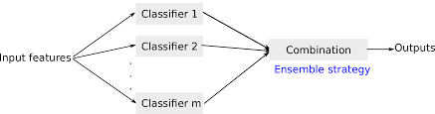
Ensemble Model
An ensemble model in machine learning is a combination of multiple individual models that work together to make predictions or decisions. Each individual model, also known as a base model or weak learner, is trained on the same dataset using a specific algorithm or technique.

Slide 6
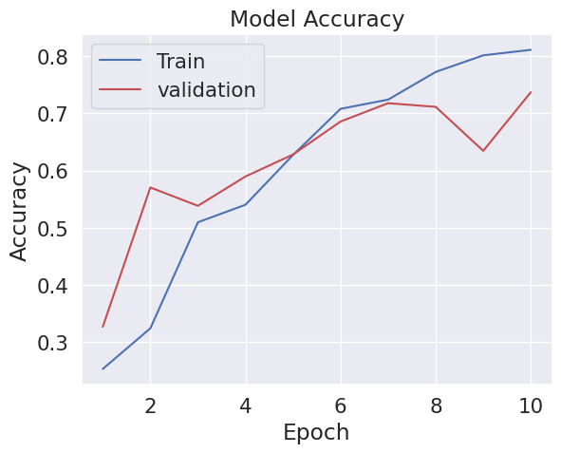
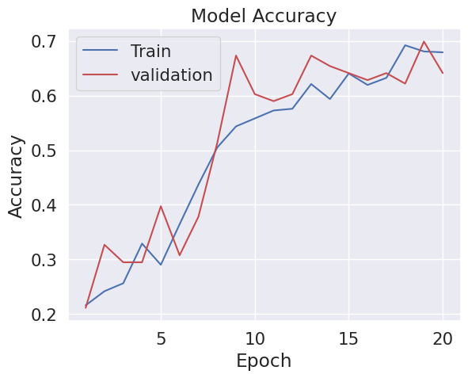
Stacking Ensemble
Stacking Ensemble is a method in machine learning that aims to make stronger predictions by combining the predictions of different machine learning models. In this method, a higher-level meta-model is created by using the predictions of different machine-learning models.

Slide 7

Tensorflow Lite File
A TFLite (TensorFlow Lite) file is a file format used in the TensorFlow platform. It is designed to run machine learning models efficiently on resource-constrained devices such as mobile and embedded devices.

Slide 8

Flutter
Flutter was used to create the mobile application.

Slide 9
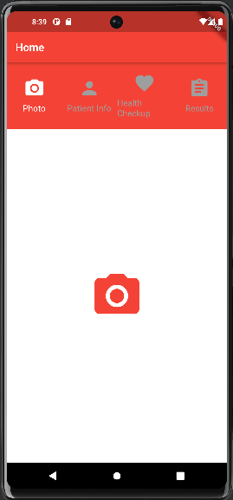
Home

Slide 10
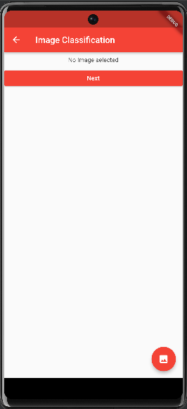
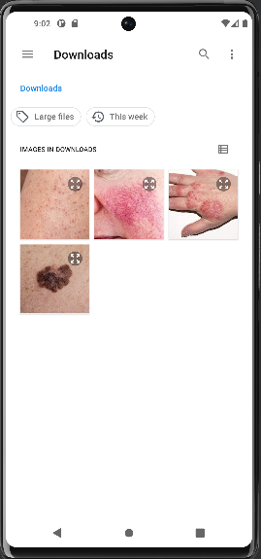
Photo

Slide 11
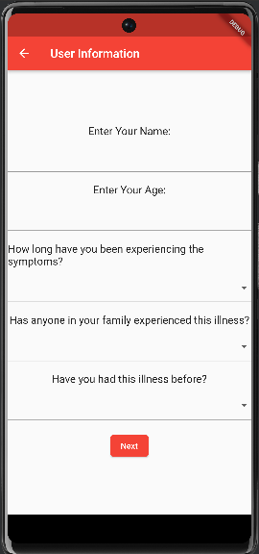
User Information

Slide 12
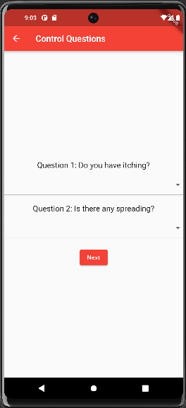
Control Questions

Slide 13
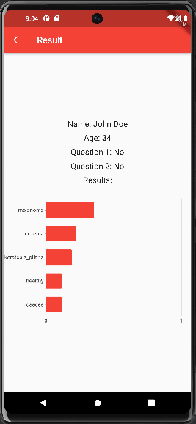
Result

Slide 14
Thank you!
Rozerin Yıldız

Slide 15
References
https://www.google.com/url?sa=i&url=https%3A%2F%2Fwww.healthline.com%2Fhealth%2Fkeratosis-pilaris-treatment&psig=AOvVaw0xlvHtZnsjG4VbF7LehJOZ&ust=1672930737829000&source=images&cd=vfe&ved=0CBAQjRxqFwoTCNjtquWWrvwCFQAAAAAdAAAAABAE
https://www.apothecopharmacy.com/blog/eczema-vs-dry-skin-how-to-tell-the-difference/
https://www.everydayhealth.com/melanoma/metastatic-melanoma/
https://towardsdatascience.com/a-comprehensive-guide-to-convolutional-neural-networks-the-eli5-way-3bd2b1164a53
https://en.wikipedia.org/wiki/Scikit-learn
https://logicoretech.com/services/python-and-django-development/
https://venturebeat.com/ai/facebook-and-microsoft-launch-pytorch-enterprise-support-program/

